Slide 1


PARKINSON’S DISEASE PREDICTION
TEAM PROJECT BY
RIZA NITHI &SRI

Slide 2

In the present decade of accelerated advances in Medical Sciences, most studies fail to lay focus on ageing diseases. These are diseases that display their symptoms at a much-advanced stage and makes a complete recovery almost improbable. Parkinson’s disease (PD) is the second most commonly diagnosed neurodegenerative disorder of the brain. Hence predicting these symptoms prior could help in curing the disease in the earliest stages.

Slide 3
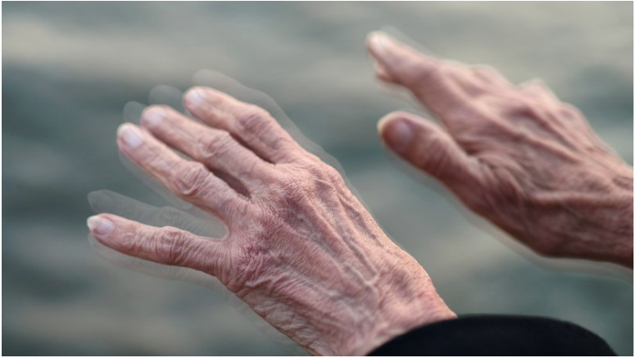
To achieve these, we will be analyzing different classification machine algorithms and will be using the most efficient algorithm classifier that yields maximum accuracy. The dataset of the Parkinson’s prediction ,will be using it from online websites (i.e.) Kaggle that contains the data of the people who gave their test. For further classification we use model testing and training and regressions models which would depict the data visualization. From the obtained result, we deploy in the web framework for the UI. Through this prediction we expect the maximum accurate test result which will help in identifying Parkinson’s disease in person.

Slide 4
TECHNICAL STACK
Website:
a web application using Python's web framework Django, plus HTML templates for the web pages such as login, dashboard and CSS for styling the pages and JavaScript for adding interactivity.
Data Structures & Statistics:
Python's built-in data structures to access the dataset, to store and manipulate data. Modules like pandas, NumPy library to analyze the data and perform statistical analysis; data visualization through sklearn and seaborn module.

Slide 5
Algorithm & Concepts Used:
Gaussian naive bayes & Bernoulli naive bayes
Logistic regression
Decision tree
Random forest criteria information gain
Random forest criteria
svm(Support Vector Machine)
Knn(K-Nearest Neighbour)

Slide 6
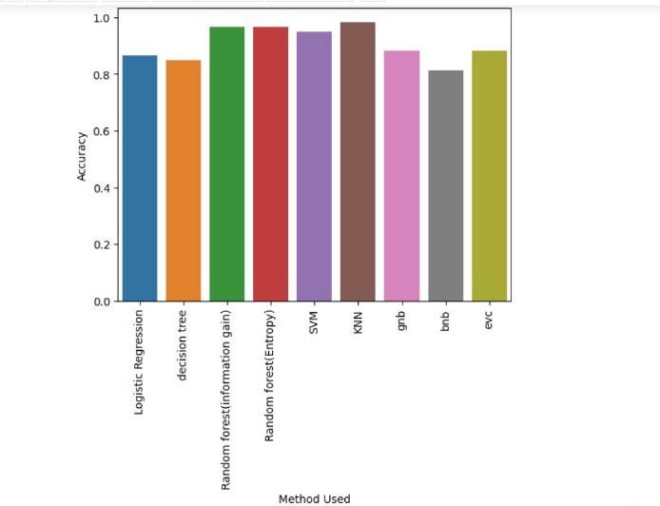
Inference: Hence the final prediction is done based on the maximum accuracy obtained using the various algorithms.
The end prediction is the outcome of test results whether it is negative or positive on Parkinson's test.

